Slide 1
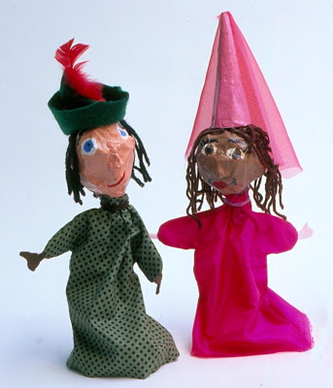
Design brief and planning
Initial Brief:
I need to create a paper mache hand puppet for my Aotearoa Haerenga project.
The puppet will be of the person or object that represents and links to my destination and will communicate my ideas well.
I have to ensure it fits with my Production Team’s overall look for our video.
I will need to consult my plans regularly to make sure I am following my final planned design.
The project must be constructed well with attention to detail regarding the person or object it is representing.
PUPPET COMPLETION DUE DATE:

Slide 2
Part 1: Stakeholders
A stakeholder is a person who could affect the solution or the solution could affect them
List the stakeholders for this project.
Give multiple reasons why they are stakeholders.
Highlight the key stakeholders.
Stakeholder | Why are they a stakeholder | How could the stakeholder be affected?

Slide 3
Part 2: Investigation
Gather some pictures of your character/object your puppet is to represent. This is to help you design how your puppet will look. Remember to consider personal features, clothing, colours and other visual elements that might be unique to your character/object.

Slide 4
Part 3: Specification
Use the images you found to help you list the characteristics you should add to your puppet to help communicate who or what it is.
Specification | Possible materials you could use
EG: brown curly hair | Strips of curled paper

Slide 5
Part 4: Concept designs
Sketchup two totally different Puppet design ideas for your person/object.
Take a photo of your sketch and place it here.

Slide 6
Part 4: Concept designs
Look at the two designs concepts that you have created. Consider how ideas could be used together or swapped around.
Take a photo of your sketch and place it here.

Slide 7
Part 5: Final concept design
Time to make a final decision. Do you go with one one of the four, or change it up again?
Notes
Method selected:
Special materials need:
Take a photo of your sketch and place it here.

