Slide 1
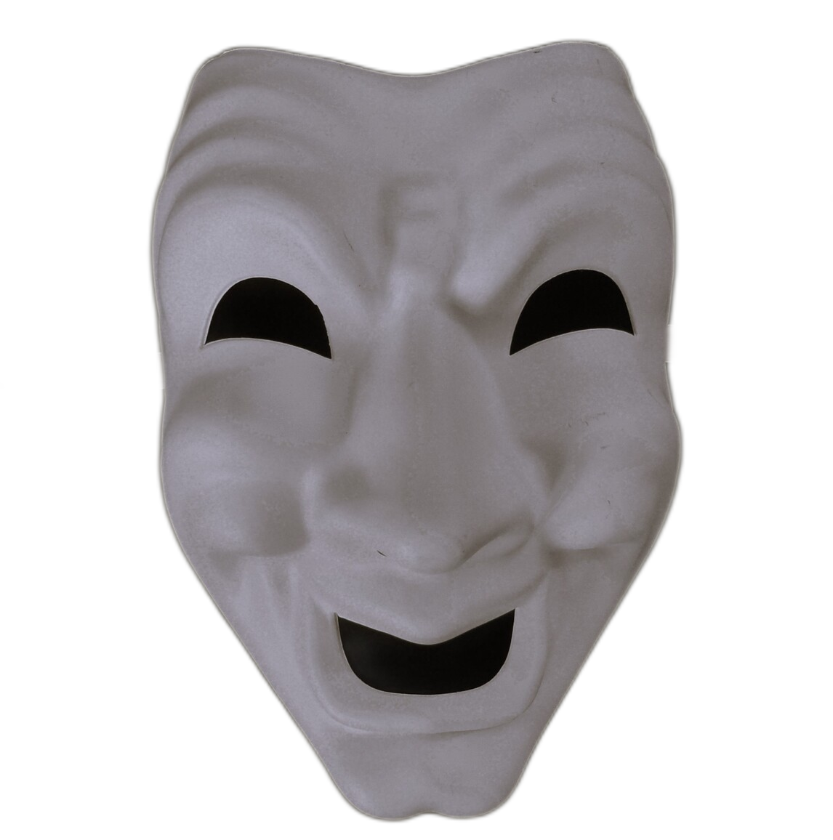
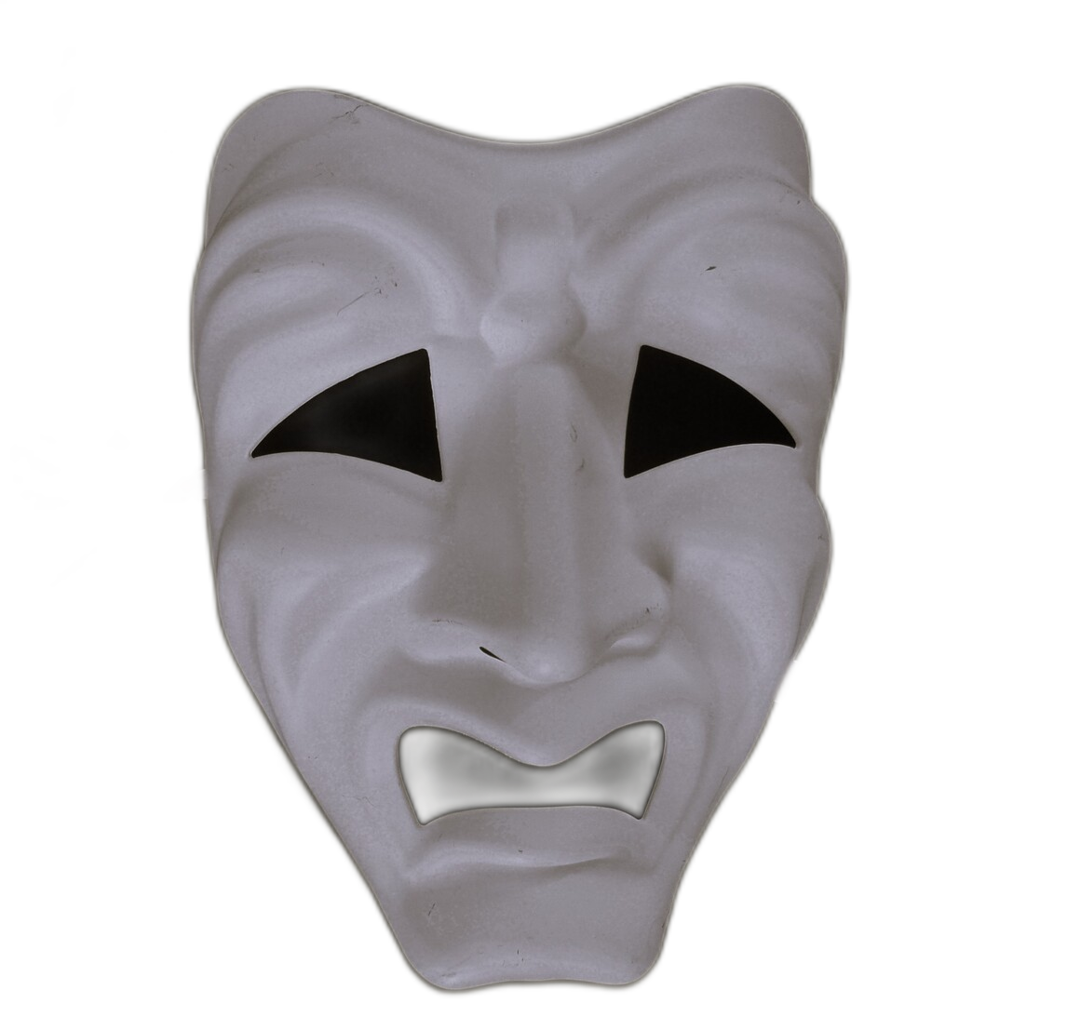
Double Trouble
Duologue Challenge

Slide 2
The Task
Work with one other person to create a duologue by blending two A/B Scripts together. Each person will develop a character that fits the situation and the place. This performance will be filmed in a single shot. Individually you will use post production tools to edit a video of your performance.
DETAILS
Up to four extra lines can be added.
Lines from chosen A/B scripts can be mixed up.
Final script is to be learnt - no scripts in hand.
Performances to be done in front of a Green Screen.

Slide 3
Getting Started
There are 10 different A/B scripts. Read through them carefully before selecting one you like.
A/B Scripts
Check here to read scripts.
Share this with a partner.
Can they be used together somehow? If not try again.

