Slide 1
Aotearoa Haerenga
New Zealand Adventure
See it!
Feel it!
New Zealand awaits you.

Slide 2
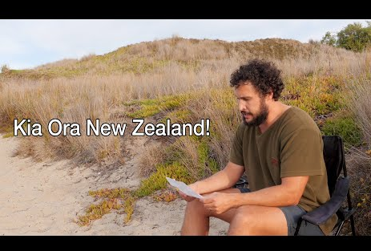

Slide 3
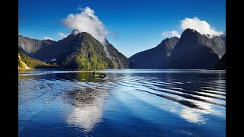

Slide 4
Aotearoa Haerenga
New Zealand Adventure
This is who we are - Where we come from
We need you!
Your Task as a production team
is to create a show that will encourage kiwis to rediscover or explore their own backyard.
A show that will remind us of what an amazing country we live in. What amazing people live here.
Places from both the North and South Island must be showcased in your show.

Slide 5
Aotearoa Haerenga
New Zealand Adventure
The tasks involved will require you to:
Work in a group, demonstrating manaakitanga, to create a presentation as a tv show,
Work independently to research and write your own section of the tv show, communicating ideas of whanaungatanga.
Work independently to create a puppet presenter.
Have fun and show haepapa.

Slide 6
Let’s get started
You will need:
to create one folder for all completed Production Team work to be place in.
one copy of this document for your Production Team as you will plan on it together.
to share the folder and document with each team member and your teacher.
to read the documents, listen to the videos together.
to discuss ideas and complete the slides in turn, as a group.

Slide 7
TV channel name
Your group needs to discuss a name for you tv channel, be as creative as you like.
Our tv channel name is …..

Slide 8
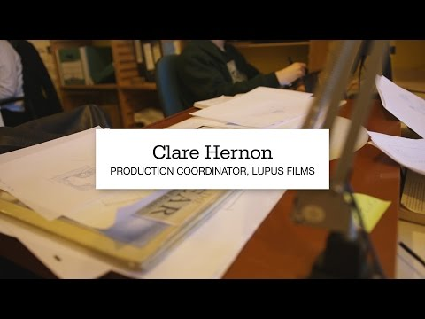
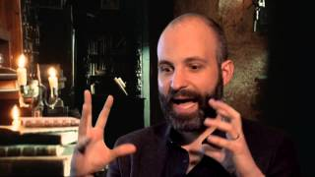
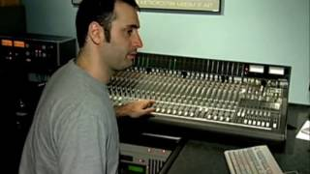
Production Team
In real life creating a show takes a lot of people, doing a lot of different jobs. Listen to the videos to help you understand the different jobs people do.
Also look at the skills listed under each job on slide 8, 9 and 11. Then discuss who suits which role for your production team.
Graphic designer Production coordinator Script editor Film editor

Slide 9
Production Coordinator
Film Editor
Put everyone’s small films together
Create the finished work
Add music and film credits
Key skills - good computer skills and able to use programmes like imovie or microsoft movie maker.
Keeps track of what people are doing
Knows when deadlines are due
Helps with anything that needs doing
Responsible for all paperwork
Key skills - organised and able to manage their time.

Slide 10
Script Editor
Advertising Executive
Helps the group check over their scripts
Read through what everyone has written
Does not write the script for everyone
Key skills - good at reading and writing and able to offer helpful advice.
Create a poster advertising your TV channel and show
Or a song/jingle for your show
Make an ad for your groups different itineraries. You could even pop this into another group's presentation.
Key skills - creative and/or artistic person

Slide 11
Our Production Team
Who will be in your group - minimum 3 people, maximum 5.
The people in our group are:
1)
2)
3)
4)
5)

Slide 12
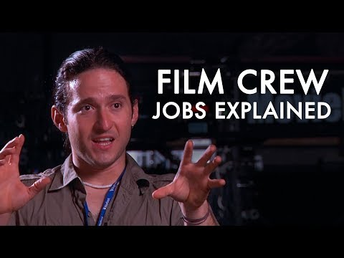
Graphic Designer
Which jobs do we need?
If your production team does not have five people, then you have two solutions.
Some people could two jobs.
The Advertising Executive can be left out.
Discuss your production teams situation and decision with your teacher.
Listening to this video may help the team.
Takes groups ideas and own to create a logo and slogan
Knows when deadlines are due
Helps Advertising Manager and Film Editor with images, maintaining the look of the show
Key skills - creative and/or artistic person/good computer skills

Slide 13
Roles in your production team?
On here you will write down who will do each role and why.
Role | Person | Why you would be good in this role
Producer
Film Editor
Script Editor
Advertising Executive
Graphic Designer

Slide 14
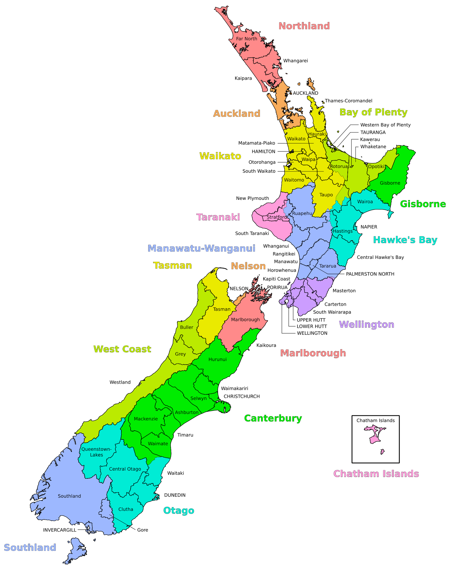
Select a New Zealand destination
So bring up a map of New Zealand and get looking.
Each member of your production team needs to select a destination in New Zealand to present on the show.
There needs to be at least 2 from each island.
Select a place outside the region you live in.

Slide 15
Where in New Zealand?
As a production team discuss , select, then record below the places in
New Zealand that you want to research and present on your programme.
Person | Name of the place | Which island is it in?

Slide 16
Hand in this first step.
The next step will be given to you as individuals to complete.

