Slide 1
How to make a Paper Mache puppet
Watch the videos to help with what to do.
Read through the expectations while working on this Visual Art project.

Slide 2
Expectations
Talking quietly while to you work is okay.
Use materials with care, only take what you need.
Clean up your materials and any mess you and your group or friends have made.
Place your work away carefully, taking care not to touch other people's work.

Slide 3
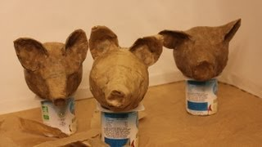
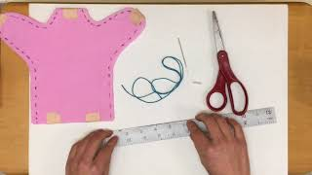
Videos
How to make a paper mache puppet using a balloon.
How to make the body for a hand puppet.

Slide 4
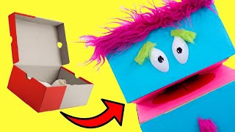
Videos
How to make a puppet using a small box.
How to make a puppet from a plastic milk bottle.

