Slide 1
Card 1 - Developing the place and motive
Place a picture in this space that the students will develop their drama about.
For example:
A forest
An abandoned building
A cemetery
Linked to Y Chart.
Groups make three decisions.
(What is that place? Why are they not allowed to be there? Why would they want to go there?)

Slide 2
Card 2 - Developing character
Who are you going to be throughout the entire performance?
You are not an adult.
You need a name and age.
What kind of person are you?
Example: Nervous, bossy, angry, happy, silly, anxious, smart, show off
As a group
Are you friends?
Are you siblings?
Are you neighbours?
How well do you know or like each other?

Slide 3
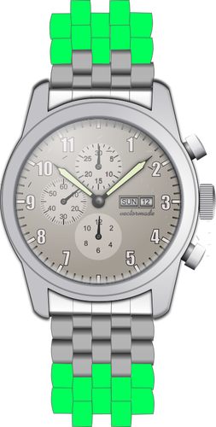
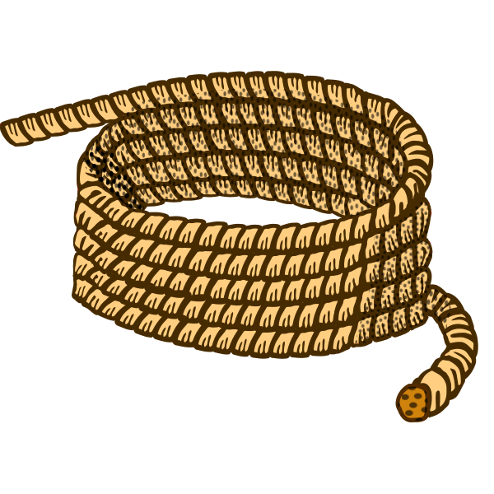
Card 3 - Develop scene 1
Activity One: Devise a scene that uses and shows the following:
Use the characters you developed in the last lesson. Do not change it and stay in role for the whole time – you are not yourself!
Decide where you are (setting) and what you are doing (situation). Why are you all together? – make this very clear!
One character is to suggest going to… (the place you decided on in the last lesson)
Remember you are not allowed to go to this place. How do you feel about going?
Characters develop an excuse to leave where they are.
This excuse is given to an imaginary adult. (Look out to the audience as if they are standing there.)
Characters grab ONE of the pictured objects on the way out – make it obvious (but do not say) what you take. CHOOSE WISELY!
Characters exit the stage and re-enter as they arrive at their destination.
How do they feel about being there? Try to show not tell us.
All characters FREEZE just before they enter the … (they should be at the edge of the stage)

Slide 4
Card 4 - Use planned character ideas and given directions to develop scene 2
Activity Two: Devise a scene to follow on from scene one.
At the end of scene one, the characters are frozen at the edge of the stage, just before they enter the forbidden place.
This scene STARTS with everyone entering the forbidden place.
Consider how they enter the space? (Stumble in/Rush in/Dragged in)
Characters react to what they find in the place.
Think about the temperature, smell, sounds and appearance where you are – how can you show these things in your acting?
Does every character want to be here?
Include some MIMED action.
You discover something, what is it? (Use the images your teacher has given you for ideas)-Card 4a
Remember the chosen object from activity one? Will this object help or hinder your discovery…
All characters FREEZE at a moment the group need to make a decision about what you have found…(you don’t know what the decision is related to)

Slide 5
Card 4a - Discovery ideas
Place a images in this space that the students could use for ideas on what they might discover in the forbidden space.
For example:
A chest
An old book
A gnarly tree
A lost shoe

Slide 6
Card 5 - Creating tension through character reaction and using given directions to develop scene 3
Activity Three: Devise a scene to follow on from scene two.
START this scene standing FROZEN in the moment of decision’ from the end of your last scene.
Your teacher will play you some music/sounds that will be included in your scene.
Choreograph a movement sequence to suit the music and reflects the reaction to the decision your group has made about what was found in scene 2.
You may choose to use mimed action, slow motion and/or chorus of voice or action.
When the music finishes something needs to happen to make you want to leave the place you are in.
Characters either leave the stage in some way, as if escaping or something might happen to them.
Do you all make it out of the safely?
Th (at least one character needs to make it back!)
One character needs to explain what has happened to an imaginary adult. (Look out to the audience as if they are standing there.)

Slide 7
Card 6 - Conclusion to scene 3.
Activity Three: Devise a scene to follow on from scene two.
Arrive on an empty stage in a manner that reflects what your characters have just been through.
At least one character needs to make it back!
One or more characters need to explain what has happened to an imaginary adult. (Look out to the audience as if they are standing there.)
The adult does not have to respond but you may have them do so if you wish. They are to speak to you while standing off stage.
It is important that you have a clear ending to your drama.

