Slide 1
Cultural Art
Banner

Slide 2
Task - What you will achieve by doing this task.
To gain an understanding of the hot and cold colours.
To create a banner that expresses something about myself and show my understanding of hot and cold colours.

Slide 3
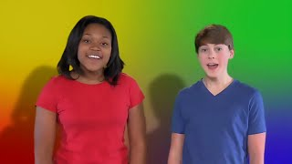
Step 1 - Watch the video.

Slide 4
Step 2 - Can you select three different cold colours and three different hot colours?
You teacher will give you a sheet to do this on.
Hot colours
Cold colours

Slide 5
Step 3 - Can you say where you might see the hot and cold colours you have chosen?
Hot colours
Cold colours
Fire
Forest
Flowers
Sea
Clouds
Sun

Slide 6
Step 4 - Making a list of the things you like.
This can be done as a class, writing the list here as the students suggest ideas. Then they go and do some drawing of the things they like from the list.
Have them try drawing at least three different things they like.

Slide 7
Step 5 - Setting up your artwork.
Your artwork will be on an A3 size piece of paper. There will be two set ways you can set up your artwork.
COLOUR: Select 1 cold colour and 1 hot colour.
The paper is divided into 6 sections.
Colour 3 squares in a cold colour.
Colour 3 squares in a hot colour.
You will have 2 different images to place in the squares.
These can be drawn by you and copied.
These can be pictures from a magazine.
These can be photocopies of images you like.

Slide 8
Example

Slide 9
Hot colours
Cold colours

Slide 10
Images of things that I like

